Slide 1
Chapter 3: STP
Instructor Materials
CCNA Routing and Switching
Scaling Networks v6.0
Notes:
Cisco Networking Academy Program
Scaling Networks v6.0
Chapter 3: STP

Slide 2
Instructor Materials – Chapter 3 Planning Guide
This PowerPoint deck is divided in two parts:
Instructor Planning Guide
Information to help you become familiar with the chapter
Teaching aids
Instructor Class Presentation
Optional slides that you can use in the classroom
Begins on slide # 27
Note: Remove the Planning Guide from this presentation before sharing with anyone.
Notes:
2

Slide 3
Chapter 3: STP
Scaling Networks v6.0 Planning Guide
Notes:
Cisco Networking Academy Program
Scaling Networks v6.0
Chapter 3: STP

Slide 4
Chapter 3: Activities
What activities are associated with this chapter?
Page # | Activity Type | Activity Name | Optional?
3.0.1.2 | Class Activity | Stormy Traffic | Optional
3.1.1.5 | Packet Tracer | Examining a Redundant Design | Optional
3.1.2.10 | Interactive Activity | Identify 802.1D Port Roles | Recommended
3.1.2.11 | Video Demonstration | Observing Spanning Tree Protocol Operation | Recommended
3.1.2.12 | Lab | Building a Switched Network with Redundant Links | Optional
3.2.1.3 | Interactive Activity | Identify Types of Spanning Tree Protocols | Recommended
3.2.2.4 | Interactive Activity | Identifying PVST+ Operation | Recommended
3.2.3.5 | Interactive Activity | Compare PVST+ and Rapid PVST+ | Recommended
The password used in the Packet Tracer activities in this chapter is: PT_ccna5
Notes:
4

Slide 5
Chapter 3: Activities (Cont.)
What activities are associated with this chapter?
Page # | Activity Type | Activity Name | Optional?
3.3.1.2 | Syntax Checker | Configure and Verify the BID | Recommended
3.3.1.3 | Syntax Checker | Configuring PortFast and BPDU Guard | Recommended
3.3.1.4 | Syntax Checker | Configuring PVST+ Load Balancing | Recommended
3.3.1.5 | Packet Tracer | Configuring PVST+ | Optional
3.3.2.2 | Packet Tracer | Configuring Rapid PVST+ | Recommended
3.3.2.3 | Lab | Configuring Rapid PVST+, PortFast, and BPDU Guard | Recommended
3.3.3.6 | Interactive Activity | Troubleshooting STP Configuration Issues | Recommended
3.3.4.3 | Interactive Activity | Identify Switch Stacking Terminology | Recommended
3.4.1.1 | Class Activity | Documentation Tree | Optional
The password used in the Packet Tracer activities in this chapter is: PT_ccna5
Notes:
5

Slide 6
Chapter 3: Assessment
Students should complete Chapter 3, “Assessment” after completing Chapter 3.
Quizzes, labs, Packet Tracers and other activities can be used to informally assess student progress.
Notes:
6

Slide 7
Chapter 3: Best Practices
Prior to teaching Chapter 3, the instructor should:
Complete Chapter 3, “Assessment.”
The objectives of this chapter are:
Explain common problems in a redundant, switched network.
Build a simple, switched network using STP.
Describe the different spanning tree varieties.
Explain how PVST+ operates.
Explain how Rapid PVST+ operates.
Configure PVST+ in a switched LAN environment.
Configure Rapid PVST+ in a switched LAN environment.
Analyze common STP configuration issues.
Explain the value of switch stacking and chassis aggregation in a small, switched LAN.
Notes:
7

Slide 8
Chapter 3: Best Practices (Cont.)
Before the lecture you may want to assign some group discussions. Have one person from each group describe the main points they discovered the day the topic is covered. Note that if you have a limited number of students, the first two bullets can be combined and the third and fourth bullets can be combined.
Differences between STP and PVST+
Differences between RSTP, Rapid PVST+, MSTP
Edge ports versus non-edge ports and how they affect spanning tree
Point-to-point links versus shared ports and how they affect spanning tree
Switch stacking and how it affects spanning tree
Notes:
8

Slide 9
Chapter 3: Best Practices (Cont.)
Draw several routers connected by WAN links on the board. Draw a rectangle somewhere and tell them it is an IP header. Remind them about source and destination IP address fields. Add a field in the rectangle and label it TTL. Explain how routers decrement this value each time a packet goes through the router. When the value gets to 0, the packet cannot be sent any further. This prevents packets from circling the Internet forever.
In a separate drawing, draw several switches and draw one or more cables between them all. Do not just connect them in a straight line.
Talk about the fact that, when data travels between switches, there is no TTL-equivalent in the Ethernet Layer 2 header. Frames that are sent that never reach their destination could theoretically travel between the switches forever.
Write the following statement on the top of the board: Spanning Tree Protocol creates ONE path through the switch network. Emphasize the words ONE and switch network. Tell everyone to keep that in mind throughout the session as you explore STP.
Notes:
9

Slide 10
Chapter 3: Best Practices (Cont.)
Write on the board the three main steps of STP and explain that there are different “flavors” of spanning tree, but they all go through the same basic process:
Elect a root bridge.
Determine the root port (RP) on each non-root bridge switch.
Determine the designated port (DP) for each link between switches.
Draw or have a topology of multiple switches with multiple connections between them. Have MAC addresses above each one such as the one shown.
11-11-11-11-11-11
22-22-22-22-22-22
33-33-33-33-33-33
SC
CE
JB
44-44-44-44-44-44
55-55-55-55-55-55
JP
JN
66-66-66-66-66-66
77-77-77-77-77-77
JW
MG
88-88-88-88-88-88
RE
Notes:
10

Slide 11
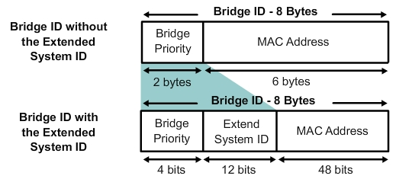
Chapter 3: Best Practices (Cont.)
Ask the student to be the spanning tree protocol (be the tree) and elect a root bridge.
Be sure to mention that in the beginning there were Layer 2 bridges, then came switches. That is why in the protocol standards and terminology for STP, the word bridge is still seen. A student can substitute the word switch for bridge if it helps them understand STP better.
Explain how a root bridge is selected based on the bridge ID (BID). In the beginning, the bridge ID had two parts, the MAC address and the bridge priority. By default, all switches come with the same bridge priority (even non-Cisco switches) so the deciding factor is MAC address and by default, the lowest MAC address wins.
Remind the students that switches operate at Layer 2 and it is LOW on the OSI model. That is a way of remembering that LOW MAC address wins in STP.
Draw a circle around the switch selected as root bridge.
To add to the lecture for those that are already working in the industry, you might show the explanation of how STP was changed to include an Extend system ID in the BID to be able to separate spanning tree instances for specific VLANs.
Notes:
11

Slide 12
Chapter 3: Best Practices (Cont.)
In continuing to “be the tree,” ask the students to determine the root port (RP) on each non-root bridge switch. For this graphic, costs have to be assigned to the links. A copy of the drawing and associated costs might be provided for the students such as the one shown.
Talk about how the LOWEST path cost back to root switch wins.
Go through one or two examples, such as the CE switch has the port on the left as the RP because the cost is 4 rather than 4 + 19 + 19 if data went the other way. The JB switch has the left-most port selected as the root port because that cost is 8 (4 + 4) to get back to root port contrasted to 38 (19 + 19) .
Remind the students that each switch gets only one RP.
Ask the students to go through and write RP on one port for each switch that is not root bridge. Show or demonstrate the calculation of the answers after a few minutes.
11-11-11-11-11-11
22-22-22-22-22-22
Cost=4
33-33-33-33-33-33
SC
Cost=4
CE
JB
Cost=19
Cost=19
Cost=19
44-44-44-44-44-44
55-55-55-55-55-55
Cost=4
JP
JN
Cost=19
Cost=19
66-66-66-66-66-66
77-77-77-77-77-77
JW
Cost=4
MG
Cost=4
88-88-88-88-88-88
RE
Notes:
12

Slide 13
Chapter 3: Best Practices (Cont.)
Path Cost
10Mb = 100
100Mb =19
155Mb = 14
1Gb = 4
10Gb = 2
Root Path Cost
Total cost to root
11-11-11-11-11-11
22-22-22-22-22-22
Cost=4
33-33-33-33-33-33
SC
Cost=4
RP
RP
CE
JB
Cost=19
Cost=19
Cost=19
44-44-44-44-44-44
55-55-55-55-55-55
RP
Cost=4
RP
JP
JN
Cost=19
Cost=19
66-66-66-66-66-66
77-77-77-77-77-77
RP
RP
JW
Cost=4
MG
Cost=4
88-88-88-88-88-88
RP
RE
Show a graphic that has each RP designated.
Go over each calculation.
Remind students that if you see a path is 4 + 19 + 19 and the other path is 4 + 19 + 19 + 4 + 4, you do not actually have to add up the cost as spanning tree does, for the exercise, you can just see which one costs less and write RP down to save time.
Notes:
13

Slide 14
Chapter 3: Best Practices (Cont.)
For the last step in “be the tree,” ask the students to select a designated port (DP) for every segment or link (red line) in the graphic.
The DP is the “talker” for the link.
The DP port is selected based on the lowest path cost for a segment.
Talk about what to do if there is a tie (because there will be one if the provided graphic is used).
All tie-breaking STP decisions are based on 4 conditions:
Lowest root Bridge ID
Lowest Root Path Cost to Root Bridge
Lowest Sender Bridge ID
Lowest Sender Port ID
Remind students that the ports on the switch that is the root bridge are automatically DPs because they are on root bridge, they are the lowest cost to get there. Have the students write the letters DP on all ports on the switch that is root bridge and that takes care of two of the segments. Do one more segment with them such as the link between CE and JB. Explain that if traffic was sitting on the port connected to CE, it would cost 4 to get back to root bridge, but if traffic was sitting over on the JB switch port that connects to the same segment, the cost would be 4 + 4 to get back to root bridge.
Notes:
14

Slide 15
Chapter 3: Best Practices (Cont.)
While the students are doing their calculations, remind them that it is in the perspective of the segment, each link or each port on either side of a link. Caution them not to do the RP calculation again. It is the most common mistake.
Give the students a few minutes, but then show the graphic and go over each calculation ESPECIALLY the tie situation for the segment between RE and MG. The port on MG wins because MG has a lower BID (MAC address) than RE.
After all of the DPs have been explained, ask the students to notice how for each RP, there is a DP on the opposite side of the link. A shortcut if time is short (such as on a certification exam), a student might go ahead and get some of the DP ports designated and only have to do the segments that do not have an RP.
11-11-11-11-11-11
22-22-22-22-22-22
Cost=4
33-33-33-33-33-33
SC
DP
Cost=4
RP
DP
RP
DP
CE
JB
Cost=19
DP
DP
Cost=19
Cost=19
44-44-44-44-44-44
Cost=4
55-55-55-55-55-55
RP
JP
DP
RP
JN
Cost=19
DP
DP
Cost=19
66-66-66-66-66-66
77-77-77-77-77-77
RP
RP
JW
DP
Cost=4
MG
DP
Cost=4
88-88-88-88-88-88
RP
RE
Notes:
15

Slide 16
Chapter 3: Best Practices (Cont.)
Now that all spanning tree calculations have been done, explain how this is what a switch does every time a new cable is inserted into a switch. This is why the port LEDs stay amber for a while. Spanning tree is trying to make sure there are no new paths through the switch network.
Tell the students that after all calculations are done, spanning tree will place a port into the blocking state if it is not an RP or a DP.
Ask the students to draw a big dark X over any ports that are not an RP or a DP port.
11-11-11-11-11-11
22-22-22-22-22-22
Cost=4
33-33-33-33-33-33
SC
DP
Cost=4
RP
DP
RP
DP
CE
JB
Cost=19
DP
DP
Cost=19
Cost=19
44-44-44-44-44-44
Cost=4
55-55-55-55-55-55
RP
JP
DP
RP
JN
Cost=19
DP
DP
Cost=19
66-66-66-66-66-66
77-77-77-77-77-77
RP
RP
JW
DP
Cost=4
MG
DP
Cost=4
88-88-88-88-88-88
RP
RE
Notes:
16

Slide 17
Chapter 3: Best Practices (Cont.)
Pretend there are PCs connected to the switches and a PC connected to JB wants to communicate with a PC connected to the JN switch. How would the traffic flow?
Show how the traffic would have to go from the JB switch → CE switch → SC switch → JP switch → JN switch.
Explain how spanning tree does not pick the BEST path for each traffic flow, but ONE path. Remind the students the goal of spanning tree – ensure there is just one path through the switch network because at Layer 2 there is no TTL value in the header.
Do another scenario or ask the students to give you one to PROVE that there is only one path through the shown switch network.
Ask the students if they notice that with all traffic flows, all traffic heads toward root bridge because that is how all calculations were done—in relation to root bridge.
11-11-11-11-11-11
22-22-22-22-22-22
Cost=4
33-33-33-33-33-33
SC
DP
Cost=4
RP
DP
RP
DP
CE
JB
Cost=19
DP
DP
Cost=19
Cost=19
44-44-44-44-44-44
Cost=4
55-55-55-55-55-55
RP
JP
DP
RP
JN
Cost=19
DP
DP
Cost=19
66-66-66-66-66-66
77-77-77-77-77-77
RP
RP
JW
DP
Cost=4
MG
DP
Cost=4
88-88-88-88-88-88
RP
RE
Notes:
17

Slide 18
Chapter 3: Best Practices (Cont.)
11-11-11-11-11-11
22-22-22-22-22-22
Cost=4
33-33-33-33-33-33
SC
Cost=4
CE
JB
Cost=19
Cost=19
Cost=19
44-44-44-44-44-44
55-55-55-55-55-55
Cost=4
JP
JN
Cost=19
Cost=19
66-66-66-66-66-66
77-77-77-77-77-77
JW
Cost=4
MG
Cost=4
88-88-88-88-88-88
RE
Explain to the students that if traffic flow is examined, it is in a company’s best interest to designate the root bridge for a particular switch if most traffic heads that way. Say that there is an internal storage server connected to the JN switch. Most people that connect to these switches use the documents on the server for their work. The network engineers within this company have designated JN as root bridge.
Ask the students to determine which ports will be blocking now. Ask them to do it in 5 minutes.
Notes:
18

Slide 19
Chapter 3: Best Practices (Cont.)
Show the solution to the students. If they did not get the same solution, ask them to re-work on their own time.
11-11-11-11-11-11
22-22-22-22-22-22
Cost=4
33-33-33-33-33-33
SC
Cost=4
CE
JB
Cost=19
Cost=19
Cost=19
44-44-44-44-44-44
55-55-55-55-55-55
Cost=4
JP
JN
Cost=19
Cost=19
66-66-66-66-66-66
77-77-77-77-77-77
JW
Cost=4
MG
Cost=4
88-88-88-88-88-88
RE
Notes:
19

Slide 20
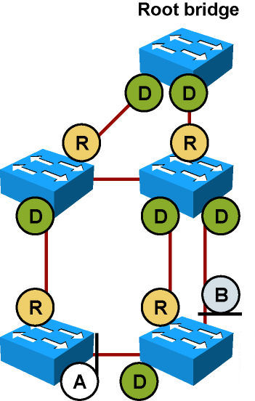
Chapter 3: Best Practices (Cont.)
Talk about how Cisco speeded up spanning tree by providing the PortFast option and where to use it (ports that always have end devices attached). Industry followed by introducing RSTP.
With RSTP, there are two new port states. Remind students of the Root Port and Designated Port states.
One new port state is the Alternate Port. An alternate port is the backup for the designated port when the other side is not a root port.
Another new port state is the Backup Port. The backup port is the backup port for the root port.
Notes:
20

Slide 21
Chapter 3: Best Practices (Cont.)
When discussing BPDUs and the process STP goes through when switches boot or a new device is connected, remind students that the output contains information about the bridge ID (BID) or local switch information and root ID – information regarding the root bridge.
Review the spanning tree port states
Disabled – spanning tree is not enabled
Listening – The port is listening to the spanning tree messages that come across as bridge protocol data units (BPDUs). The port is NOT forwarding frames.
Learning – The port is adding MAC addresses to the MAC address table (learning MAC addresses), but still not forwarding frames yet.
Forwarding – The spanning tree calculation has run and if the port is a root port or designated port, the port turns green and can send and receive data.
Blocking – The spanning tree calculation has run and because the port is not a root or designated port, the port turns amber, does not send or receive data, but it still listens for BPDU messages. Note that when a switch first turns on, all ports are in the blocking state by default.
Notes:
21

Slide 22
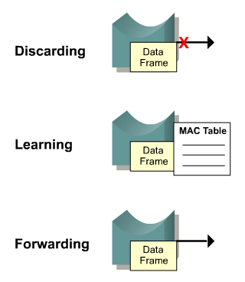
Chapter 3: Best Practices (Cont.)
Review RSTP port states
Remember that with RSTP, there is no more disabled, blocking, or listening states. There are only the following states:
Discarding – no data frames are being sent out the port
Learning – The port is adding MAC addresses to the MAC address table (learning MAC addresses), but still not forwarding frames yet.
Forwarding – The spanning tree calculation has run and if the port is a root port or designated port, the port turns green and can send and receive data.
STP (802.1D) Port State | RSTP (802.1w) Port State
Disabled | Discarding
Blocking | Discarding
Listening | Discarding
Learning | Learning
Forwarding | Forwarding
Notes:
22

Slide 23
Chapter 3: Best Practices (Cont.)
Emphasize to the students that spanning tree issues do occur, STP is not understood well by many, and STP is on by default and should NEVER be turned off. If error messages occur, troubleshoot the cause, do NOT turn spanning tree off.
A senior network engineer told this story to a tour being given to Cisco Academy students: Have you been taught spanning tree? When the students replied yes, he said let me tell you one of my gravest mistakes as a young network administrator. He was working from Florida on a switch in their Washington state office. That office had few traders and no in-house support staff. The site was supported and maintained by those in Florida. Spanning tree errors were occurring on the Washington switches. The network administrator turned spanning tree off and within one minute could no longer access the switch. The administrator remotely accessed a different switch, but soon the administrator was locked out of that switch as well. The administrator had to get on a plane and fly across the country to physically console into the switches, turn spanning tree back on, and then troubleshoot the spanning tree problem. The moral of this story is to NEVER turn spanning tree off. It is there to help with Layer 2 redundancy issues.
Notes:
23

Slide 24
Chapter 3: Best Practices (Cont.)
In order to handle STP problems, the network engineer must understand how STP operates.
Spanning tree issues include slow traffic flow, slow remote connectivity to a switch in the affected area, and increase of dropped frames.
Show the flowchart on 3.3.3.1. Key troubleshooting commands:
show cdp neighbors - see if adjacent devices can see each other. CDP is a Layer 2 technology that verifies whether one Cisco device can detect another directly connected Cisco device.
show spanning-tree vlan vlan_number – used to verify root bridge and port states. A technician should know what the STP states are normally, but this is not always realistic in the field.
Techniques to fix STP issues:
Identify the VLAN or set of switches affected by the problem.
Ensure the affected topology is known (what specific ports are used between two switches).
Disconnect redundant links or shut the redundant ports down, if possible.
Restore disconnected redundant links one by one to monitor affects on spanning tree.
Notes:
24

Slide 25
Chapter 3: Additional Help
For additional help with teaching strategies, including lesson plans, analogies for difficult concepts, and discussion topics, visit the CCNA Community at: https://www.netacad.com/group/communities/community-home
Best practices from around the world for teaching CCNA Routing and Switching. https://www.netacad.com/group/communities/ccna
If you have lesson plans or resources that you would like to share, upload them to the CCNA Community in order to help other instructors.
Students can enroll in Introduction to Packet Tracer (self-paced).
A good time for students to take the CCENT certification is after taking RSE, but some take it while taking the ScaN course. Students preparing for the CCENT certification, could view the 15 lessons and videos contained at the Cisco Networking/CCENT Wikiversity site: https://en.wikiversity.org/wiki/Cisco_Networking/CCENT
Notes:
25

Slide 27
Chapter 3: STP
CCNA Routing and Switching
Scaling Networks v6.0
Notes:
Cisco Networking Academy Program
Scaling Networks v6.0
Chapter 3: STP

Slide 28
Chapter 3 - Sections & Objectives
3.1 Spanning Tree Concepts
Build a simple switched network with redundant links.
Explain common problems in a redundant, switched network.
Build a simple, switched network using STP.
3.2 Varieties of Spanning Tree Protocols
Explain how different varieties of spanning tree protocols operate.
Describe the different spanning tree varieties.
Explain how PVST+ operates.
Explain how Rapid PVST+ operates.
Notes:
28
Cisco Networking Academy Program
Scaling Networks v6.0
Chapter 3: STP

Slide 29
Chapter 3 - Sections & Objectives (Cont.)
3.3 Spanning Tree Configuration
Implement PVST+ and Rapid PVST+ in a switched LAN environment.
Configure PVST+ in a switched LAN environment.
Configure Rapid PVST+ in a switched LAN environment.
Analyze common STP configuration issues.
Notes:
29
Cisco Networking Academy Program
Scaling Networks v6.0
Chapter 3: STP

Slide 30
3.1 STP Operation
Notes:
3 – STP
3.1 – STP Operation

Slide 31
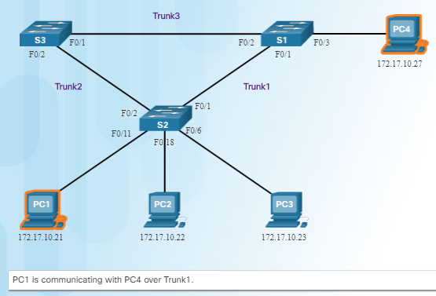
Spanning Tree Redundancy at OSI Layers 1 and 2
Switched networks commonly have redundant paths and even redundant links between the same two devices.
Redundant paths eliminate a single point of failure in order to improve reliability and availability.
Redundant paths can cause physical and logical Layer 2 loops.
Spanning Tree Protocol (STP) is a Layer 2 protocol that helps especially when there are redundant links.
Layer 2 loop issues
Mac database instability – copies of the same frame being received on different ports.
Broadcast storms – broadcasts are flooded endlessly causing network disruption.
Multiple frame transmission – multiple copies of unicast frames delivered to the same destination.
Notes:
3.1 – STP Operation
3.1.1 – Spanning Tree
3.1.1.1 – Redundancy at OSI Layers 1 and 2

Slide 32
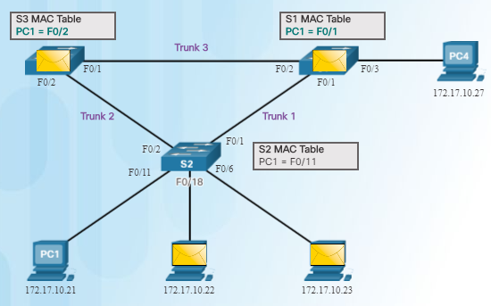
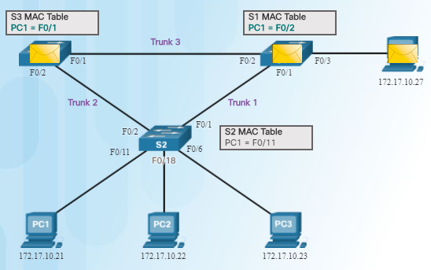
Spanning Tree Issues with Layer 1 Redundancy: MAC Database Instability
Ethernet frames do not have a time to live (TTL) field like the Layer 3 IP header has. This means that Ethernet has no mechanism to drop frames that propagate endlessly. This can
result in MAC database instability.
PC1 sends a broadcast frame to S2.
S2 updates the MAC address table for PC1’s MAC address on port 11.
S2 forwards the frame out all ports except the port the frame came in on. S1 and S3 receive the frame on a trunk and update their own MAC address tables that PC1 is reachable through the trunk port.
S1 and S3 send the frame out all ports except the port it came in on.
When S1 sends the frame out port 2 (Trunk 3), S3 updates the MAC address table to reflect that PC1 is now reachable through port 1.
A host caught in a network loop is not accessible to other hosts.
Due to constant changes in the MAC address table, Switches S3 and S1 do not know which port to forward frames.
Notes:
3.1 – STP Operation
3.1.1 – Spanning Tree
3.1.1.2 – Issues with Layer 1 Redundancy: MAC Database Instability

Slide 33
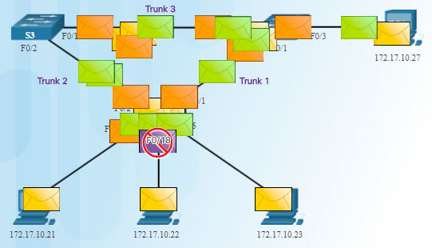
Spanning Tree Issues with Layer 1 Redundancy: Broadcast Storms
Broadcast storm – so many broadcast frames in a Layer 2 loop that use all available bandwidth and make the network unreachable for legitimate network traffic.
Causes a denial of service (DoS)
Can develop in seconds and bring the network down
Notes:
3.1 – STP Operation
3.1.1 – Spanning Tree
3.1.1.3 – Issues with Layer 1 Redundancy: Broadcast Storms

Slide 34
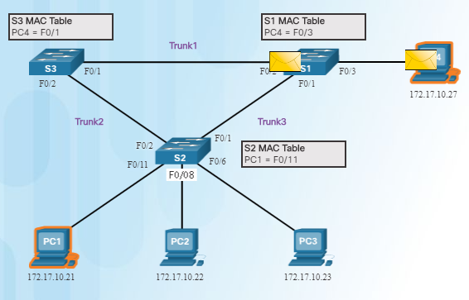
Spanning Tree Issues with Layer 1 Redundancy: Duplicate Unicast Frames
An unknown unicast frame is when the switch does not have the destination MAC address in its MAC address table and has to broadcast the frame out all ports except the port the frame was received on (the ingress port).
Unknown unicast frames sent onto a looped network can result in duplicate frames arriving at the destination device.
PC1 sends a frame destined for PC4.
S2 does not have PC4’s MAC address in the MAC address table so it forwards the frame out all ports including the trunks that lead to S1 and S3. S1 sends the frame to PC4. S3 also sends a copy of the frame over to S1 which delivers the same frame again to PC4.
Notes:
3.1 – STP Operation
3.1.1 – Spanning Tree
3.1.1.4 – Issues with Layer 1 Redundancy: Duplicate Unicast Frames

Slide 35
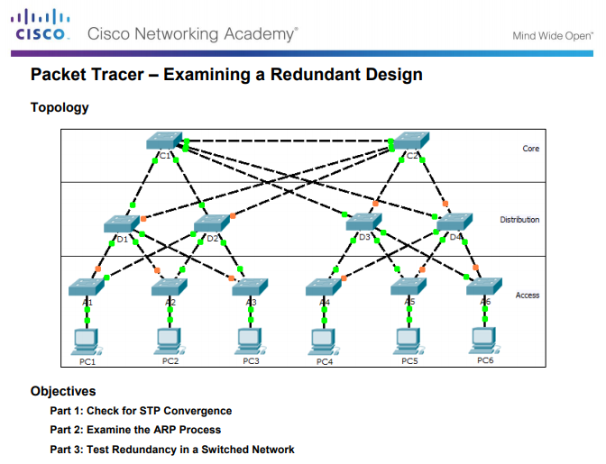
Types of NAT Packet Tracer – Examining a Redundant Design
Notes:
3.1 – STP Operation
3.1.1 – Spanning Tree
3.1.1.5 – Packet Tracer - Examining a Redundant Design

Slide 36
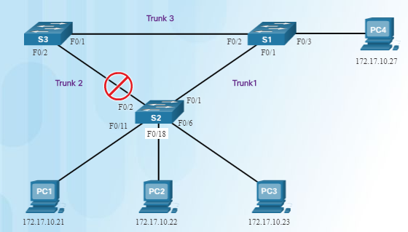
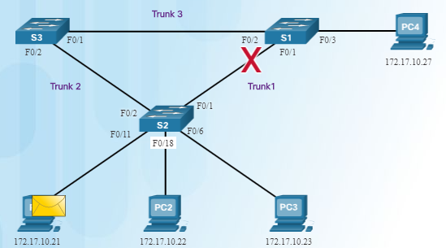
STP Operation Spanning Tree Algorithm: Introduction
The Spanning Tree Protocol (STP) creates one logical path through the switch network (all destinations on the network).
Blocks redundant paths that could cause a loop.
STP sends bridge protocol data units (BPDUs) between Layer 2 devices in order to create the one logical path.
A port on S2 is blocked so traffic can only flow one way between any two devices.
When Trunk1 fails, the blocked port on S2 is unblocked and traffic can flow between S2 and S3.
Notes:
3.1 – STP Operation
3.1.2 – STP Operation
3.1.2.1 – Spanning Tree Algorithm: Introduction

Slide 37
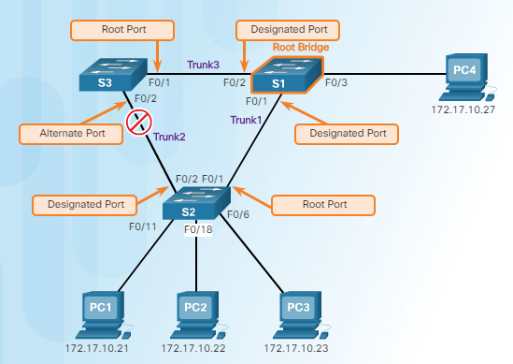
STP Operation Spanning Tree Algorithm: Port Roles
Root bridge – one Layer 2 device in a switched network.
Root port – one port on a switch that has the lowest cost to reach the root bridge.
Designated port – selected on a per-segment (each link) basis, based on the cost to get back to root bridge for either side of the link.
Alternate port – (RSTP only) backup port for the designated port when the other side is not a root port.
Backup port – (RSTP only) backup port for the root port.
Notes:
3.1 – STP Operation
3.1.2 – STP Operation
3.1.2.2 – Spanning Tree Algorithm: Port Roles

Slide 38
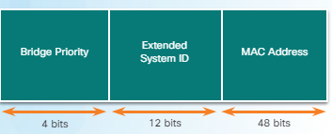
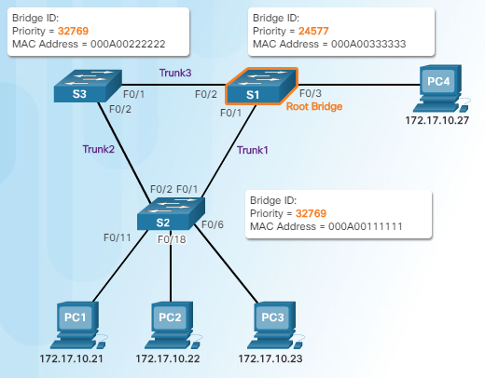
STP Operation Spanning Tree Algorithm: Root Bridge
Supports per-VLAN STP operations
Lowest bridge ID (BID) becomes root bridge
Originally BID had two fields: bridge priority and MAC address
Bridge priority default is 32,768 (can change)
Lowest MAC address (if bridge priority is not changed) becomes determinant for root bridge.
Notes:
3.1 – STP Operation
3.1.2 – STP Operation
3.1.2.3 – Spanning Tree Algorithm: Root Bridge

Slide 39


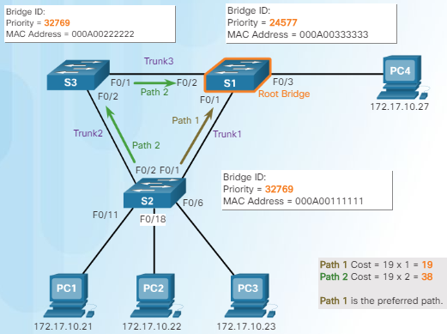

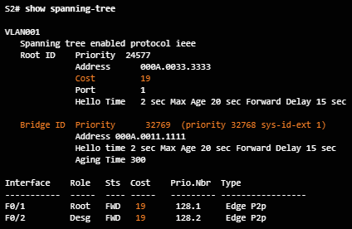
STP Operation Spanning Tree Algorithm: Root Path Cost
Root path cost is used to determine the role of the port and whether or not traffic is blocked.
Can be modified with the spanning-tree cost interface command.
Notes:
3.1 – STP Operation
3.1.2 – STP Operation
3.1.2.4 – Spanning Tree Algorithm: Root Path Cost

Slide 40
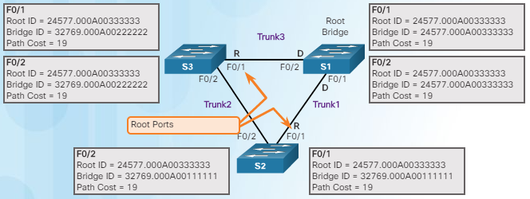
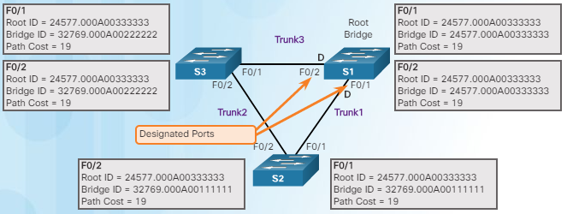
STP Operation Port Role Decisions for RSTP
S1 is root bridge
Notes:
3.1 – STP Operation
3.1.2 – STP Operation
3.1.2.5 – Port Role Decisions for RSTP

Slide 41
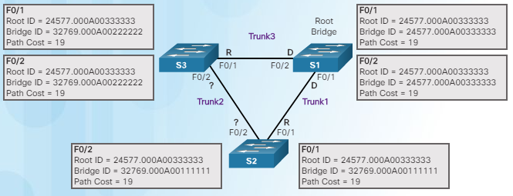
STP Operation Port Role Decisions for RSTP (Cont.)
Which port is the designated port?
Which switch (S3 or S2) has the lowest BID?
After S3 and S2 exchange BPDUs, STP determines that the F0/2 port on S2 becomes the designated port and the S3 F0/2 port becomes the alternate port, thus going into the blocking state so there is only one path through the switched network.
Notes:
3.1 – STP Operation
3.1.2 – STP Operation
3.1.2.5 – Port Role Decisions for RSTP (Cont.)

Slide 42
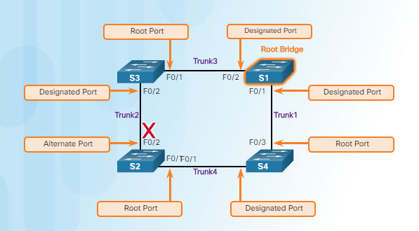
STP Operation Determine Designated and Alternate Ports
Remember port states are based on path cost back to root bridge.
Notes:
3.1 – STP Operation
3.1.2 – STP Operation
3.1.2.6 – Determine Designated and Alternate Ports

Slide 43
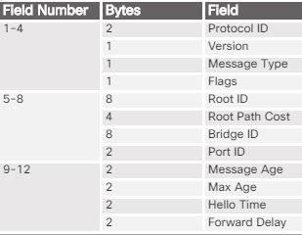
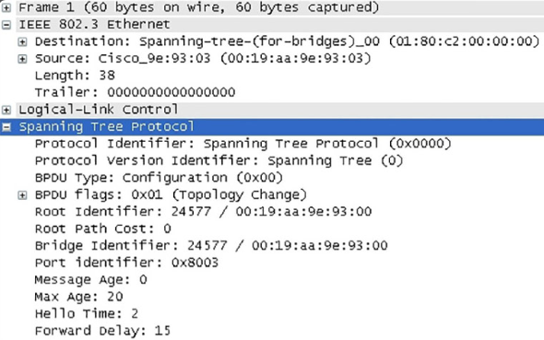
STP Operation 802.1D BPDU Frame Format
Field | Description
Protocol ID | Type of protocol being used; set to 0
Version | Protocol version; set to 0
Message type | Type of message; set to 0
Flags | Topology change (TC) bit signals a topology a change; topology change acknowldgment (TCA) bit used when a configuration message with the TC bit set has been received
Root ID | Root bridge information
Root path cost | Cost of the path from the switch sending the configuration message to the root bridge
Bridge ID | Includes priority, extended system ID, and MAC address ID of the bridge sending the message
Port ID | Port number from which the BPDU was sent
Message age | Amount of time since the root bridge sent the configuration message
Max age | When the current configuration message will be deleted
Hello time | Time between root bridge messages
Forward delay | Time the bridges should wait before going to a new state
Notes:
3.1 – STP Operation
3.1.2 – STP Operation
3.1.2.7 – 802.1D BPDU Frame Format

Slide 44
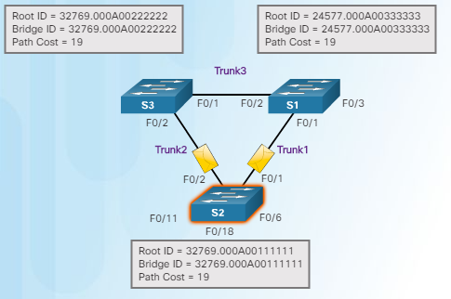
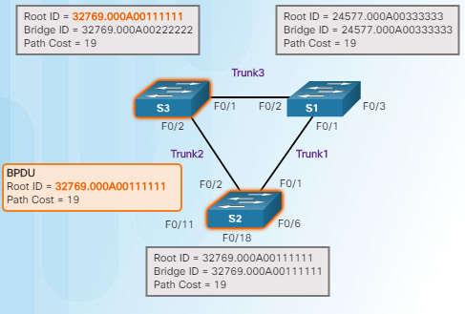
STP Operation 802.1D BPDU Propagation and Process
When a switch is powered on, it assumes it is the root bridge until BPDUs are sent and STP calculations are performed. S2 sends out BPDUs.
S3 compares its root ID with the BPDU from S2. S2 is lower so S3 updates its root ID.
Notes:
3.1 – STP Operation
3.1.2 – STP Operation
3.1.2.8 – 802.1D BPDU Propagation and Process

Slide 45
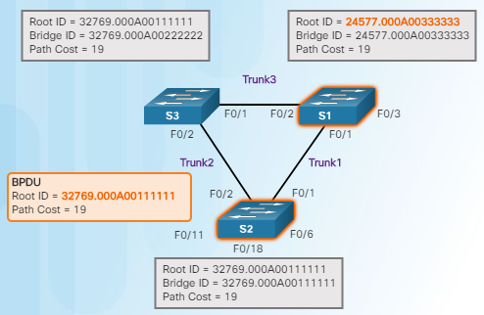
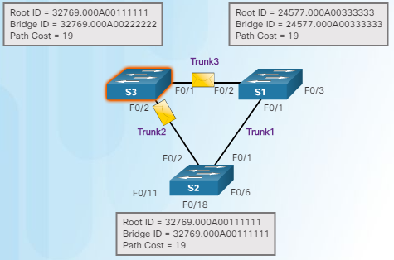
STP Operation 802.1D BPDU Propagation and Process (Cont.)
S1 receives the same information from S2 and because S1 has a lower BID, it ignores the information from S2.
S3 sends BPDUs out all ports indicating that S2 is root bridge.
Notes:
3.1 – STP Operation
3.1.2 – STP Operation
3.1.2.8 – 802.1D BPDU Propagation and Process (Cont.)

Slide 46
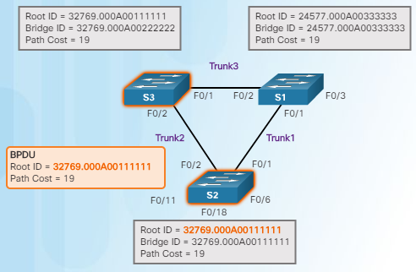
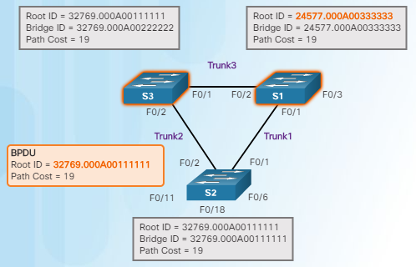
STP Operation 802.1D BPDU Propagation and Process (Cont.)
S2 compares the info from S3 so S2 still thinks it is root bridge.
S1 gets the same information from S3 (that S2 is root bridge), but because S1 has a lower BID, the switch ignores the information in the BPDU.
Notes:
3.1 – STP Operation
3.1.2 – STP Operation
3.1.2.8 – 802.1D BPDU Propagation and Process (Cont.)

Slide 47
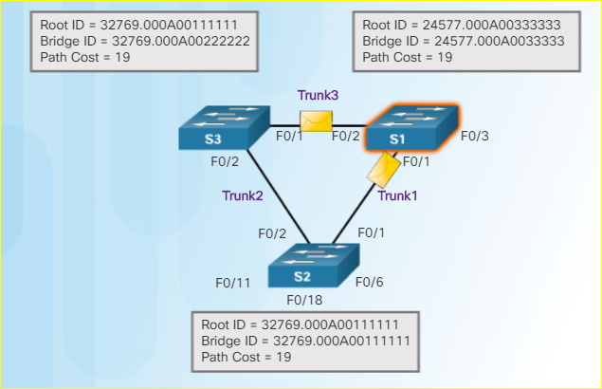
STP Operation 802.1D BPDU Propagation and Process (Cont.)
7. S1 now sends out BPDUs out all ports. The BPDU contains information designated S1 as root bridge.
Notes:
3.1 – STP Operation
3.1.2 – STP Operation
3.1.2.8 – 802.1D BPDU Propagation and Process (Cont.)

Slide 48
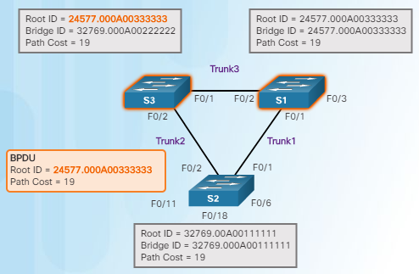
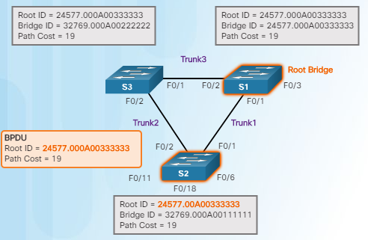
STP Operation 802.1D BPDU Propagation and Process (Cont.)
S3 compares the info from S1 so S3 now sees that the BID from S1 is lower than its stored root bridge information which is currently showing that S2 is root bridge. S3 changes the root ID to the information received from S1.
S2 compares the info from S1 so S2 now sees the BID from S1 is lower than its own BID. S2 now updates its own information showing S1 as root bridge.
Remember that after root bridge has been determined, the other port roles can be determined because those roles are determined by total path cost back to root bridge.
Notes:
3.1 – STP Operation
3.1.2 – STP Operation
3.1.2.8 – 802.1D BPDU Propagation and Process (Cont.)

Slide 49
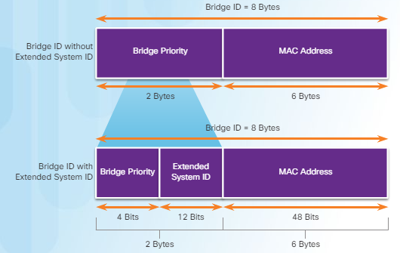
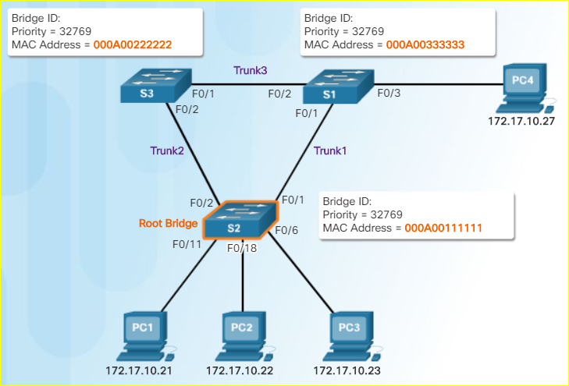
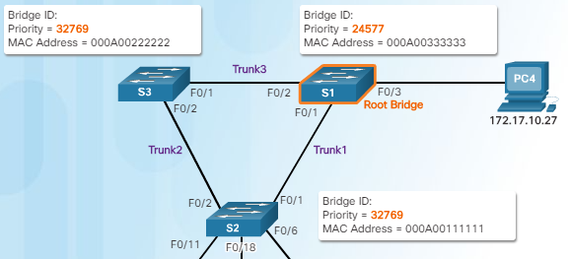
STP Operation Extended System ID
Remember - lowest BID becomes root
If priorities are all set to the default, lowest MAC address is the determining factor in lowest BID.
The priority value can be modified to influence root bridge elections.
Notes:
3.1 – STP Operation
3.1.2 – STP Operation
3.1.2.9 – Extended System ID

Slide 50
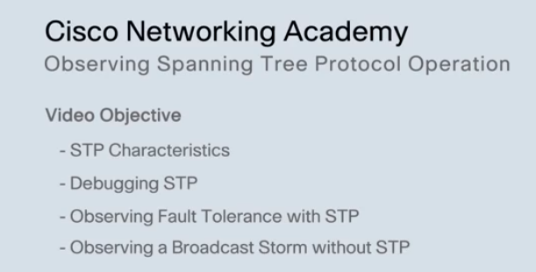
STP Operation Video Demonstration – Observing Spanning Tree Protocol Operation
Notes:
3.1 – STP Operation
3.1.2 – STP Operation
3.1.2.11 – Video Demonstration – Observing Spanning Tree Protocol Operation

Slide 51
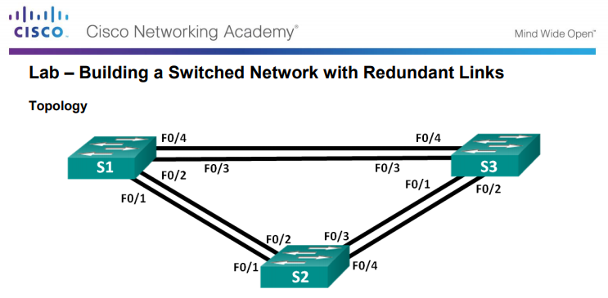
STP Operation Building a Switched Network with Redundant Links
Notes:
3.1 – STP Operation
3.1.2 – STP Operation
3.1.2.12 – Lab – Building a Switched Network with Redundant Links

Slide 52
3.2 Types of Spanning Tree Protocols
Notes:
3 – STP
3.2 – Types of Spanning Tree Protocols

Slide 53
Varieties of Spanning Tree Protocols Types of Spanning Tree Protocols
STP Type | Description
802.1D | 1998 - Original STP standard
CST | One spanning-tree instance
PVST+ | Cisco update to 802.1D; each VLAN has its own spanning-tree instance
802.1D | 2004 – Updated bridging and STP standard
802.1w (RSTP) | Improves convergence by adding new roles to ports and enhancing BPDU exchange
Rapid PVST+ | Cisco enhancement of RSTP using PVST+
802.1s (MSTP) | Multiple VLANs can have the same spanning-tree instance
Notes:
3.2 – STP
3.2.1 – Varieties of Spanning Tree Protocols
3.2.1.1 – Types of Spanning Tree Protocols

Slide 54
Varieties of Spanning Tree Protocols Characteristics of Spanning Tree Protocols
STP Type | Standard | Resources Needed | Convergence | Tree Calculation
STP | 802.1D | Low | Slow | All VLANs
PVST+ | Cisco | High | Slow | Per VLAN
RSTP | 802.1w | Medium | Fast | All VLANs
Rapid PVST+ | Cisco | Very high | Fast | Per VLAN
MSTP | 802.1s | Medium or high | Fast | Per instance
Notes:
3.2 – STP
3.2.1 – Varieties of Spanning Tree Protocols
3.2.1.2 – Characteristics of Spanning Tree Protocols

Slide 55
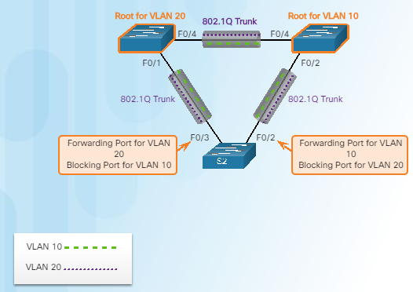
Varieties of Spanning Tree Protocols Overview of PVST+
Original 802.1D defines a common spanning tree
One spanning tree instance for the switched network (no matter how many VLANs)
No load sharing
One uplink must block for all VLANs
Low CPU utilization because only one instance of STP is used/calculated
Cisco PVST+ - each VLAN has its own spanning tree instance
One port can be blocking for one VLAN and forwarding for another VLAN
Can load balance
Can stress the CPU if a large number of VLANs are used
Notes:
3.2 – STP
3.2.1 – Varieties of Spanning Tree Protocols
3.2.2.1 – Overview of PVST+

Slide 56
Varieties of Spanning Tree Protocols Port States and PVST+ Operation
Port State
Operation allowed | Blocking | Listening | Learning | Forwarding | Disabled
Can receive/process BPDUs | Yes | Yes | Yes | Yes | No
Can forward data frames received on an interface | No | No | No | Yes | No
Can forward data frames switched from another interface | No | No | No | Yes | No
Can learn MAC addresses | No | No | Yes | Yes | No
Notes:
3.2 – STP
3.2.1 – Varieties of Spanning Tree Protocols
3.2.2.2 – Port States and PVST+ Operation

Slide 57
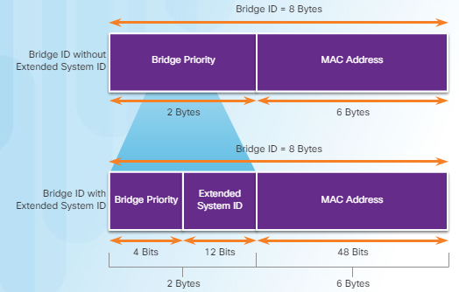
Varieties of Spanning Tree Protocols Extended System ID and PVST+ Operation
Remember that the BID is a unique ID
The extended system ID field ensures each switch has a unique BID for each VLAN.
The VLAN number is added to the priority value.
Example – VLAN 2 priority is 32770 (default value of 32768 plus the VLAN number of 2 equals 32770)
Can modify the priority number to influence the root bridge decision process
Reasons to select a particular switch as root bridge
Switch is positioned such that most traffic patterns flow toward this particular switch
Switch has more processing power (better CPU)
Switch is easier to access and manage remotely
Notes:
3.2 – STP
3.2.1 – Varieties of Spanning Tree Protocols
3.2.2.3 – Extended System ID and PVST+ Operation

Slide 58
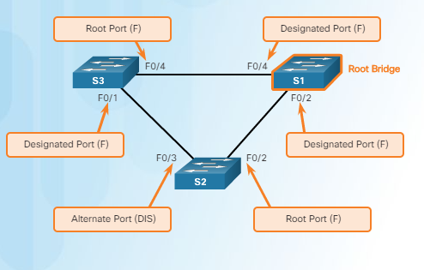
Varieties of Spanning Tree Protocols Overview of Rapid PVST+
Rapid PVST+ speeds up STP recalculations and converges quicker
Cisco version of RSTP
Two new port types
Alternate port (DIS)
Backup port
Independent instance of RSTP runs for each VLAN
Cisco features such as UplinkFast and BackboneFast are not compatible with switches that run RSTP
Notes:
3.2 – STP
3.2.1 – Varieties of Spanning Tree Protocols
3.2.3.1 – Overview of Rapid PVST+

Slide 59
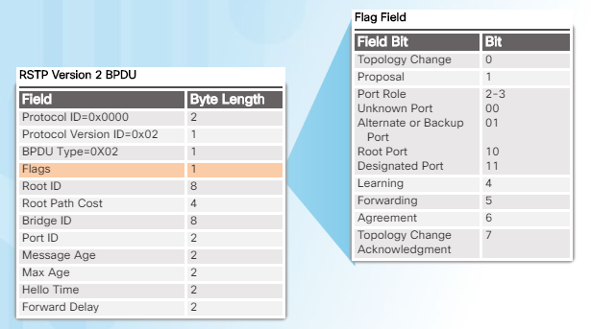
Varieties of Spanning Tree Protocols RSTP BPDUs
RSTP uses type 2, version 2 BPDUs
Original version was type 0, version 0
A switch using RSTP can work with and communicate with a switch running the original 802.1D version
BPDUs are used as a keepalive mechanism
3 missed BPDUs indicates lost connectivity
Notes:
3.2 – STP
3.2.1 – Varieties of Spanning Tree Protocols
3.2.3.2 – RSTP BPDUs

Slide 60
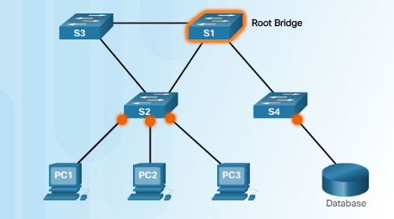
Varieties of Spanning Tree Protocols Edge Ports
Has an end device connected – NEVER another switch
Immediately goes to the forwarding state
Functions similar to a port configured with Cisco PortFast
Use the spanning-tree portfast command
Edge port
Edge port
Notes:
3.2 – STP
3.2.1 – Varieties of Spanning Tree Protocols
3.2.3.3 – Edge Ports

Slide 61
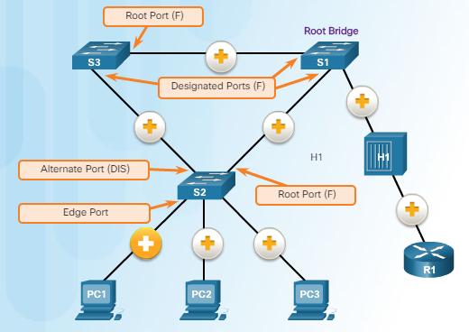
Varieties of Spanning Tree Protocols Link Types
Point-to-Point – a port in full-duplex mode connecting from one switch to another switch or from a device to a switch
Shared – a port in half-duplex mode connecting a hub to a switch
Point-to-Point
Shared
Notes:
3.2 – STP
3.2.1 – Varieties of Spanning Tree Protocols
3.2.3.4 – Link Types

Slide 62
3.3 Spanning Tree Configuration
Notes:
3 – STP
3.3 – Spanning Tree Configuration

Slide 63
PVST+ Configuration Catalyst 2960 Default Configuration
Feature | Default Setting
Enable state | Enabled on VLAN 1
Spanning-tree mode | PVST+ (Rapid PVST+ and MSTP are disabled)
Switch priority | 32768
Spanning-tree port priority (configurable on a per-interface basis) | 128
Spanning-tree port cost (configurable on a per-interface basis) | 1000 Mb/s: 4 100 Mb/s: 19 10 Mb/s: 100
Spanning-tree VLAN port priority (configurable on a per-VLAN basis) | 128
Spanning-tree VLAN port cost (configurable on a per-VLAN basis) | 1000 Mb/s: 4 100 Mb/s: 19 10 Mb/s: 100
Spanning-tree timers | Hello time: 2 seconds Forward-delay time: 15 seconds Maximum-aging time: 20 seconds Transmit hold count: 6 BPDUs
Notes:
3.3 – Spanning Tree Configuration
3.3.1 – PVST+ Configuration
3.3.1.1 – Catalyst 2960 Default Configuration

Slide 64
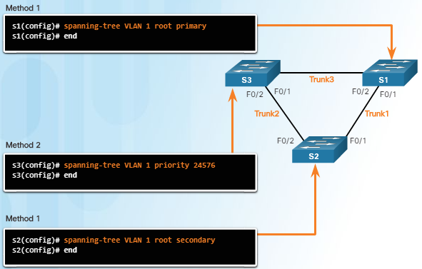
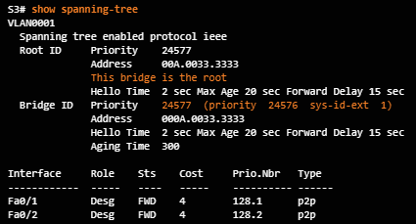
PVST+ Configuration Configuring and Verifying the Bridge ID
Two ways to influence the root bridge election process
Use the spanning-tree vlan x root primary or secondary command.
Change the priority value by using the spanning-tree vlan x priority x command.
Verify the bridge ID and root bridge election by using the show spanning-tree command.
Notes:
3.3 – Spanning Tree Configuration
3.3.1 – PVST+ Configuration
3.3.1.2 – Configuring and Verifying the Bridge ID

Slide 65
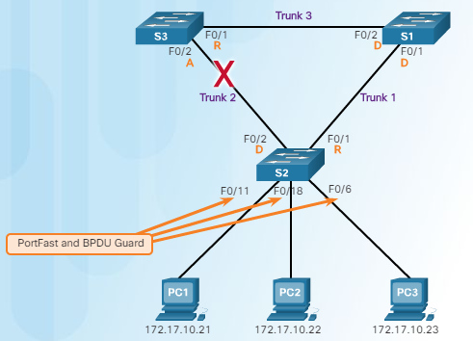
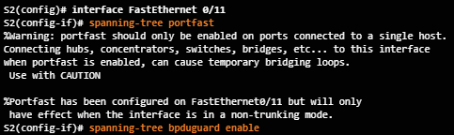
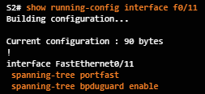
PVST+ Configuration PortFast and BPDU Guard
PortFast is used on ports that have end devices attached.
Puts a port in the forwarding state
Allows DHCP to work properly
BPDU Guard disables a port that has PortFast configured on it if a BPDU is received
Notes:
3.3 – Spanning Tree Configuration
3.3.1 – PVST+ Configuration
3.3.1.3 – PortFast and BPDU Guard

Slide 66
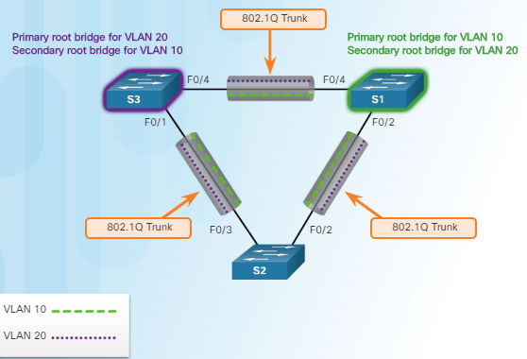
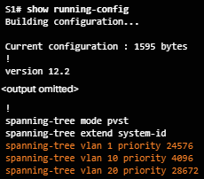
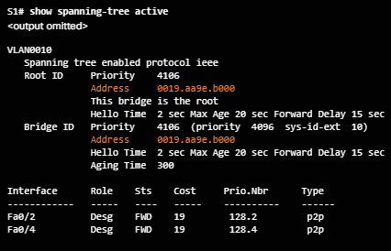
PVST+ Configuration PVST+ Load Balancing
or
or
Notes:
3.3 – Spanning Tree Configuration
3.3.1 – PVST+ Configuration
3.3.1.4 – PVST+ Load Balancing

Slide 67

PVST+ Configuration Packet Tracer – Configuring PVST+
Notes:
3.3 – Spanning Tree Configuration
3.3.1 – PVST+ Configuration
3.3.1.5 – Packet Tracer – Configuring PVST+

Slide 68




Rapid PVST+ Configuration Spanning Tree Mode
Rapid PVST+ supports RSTP on a per-VLAN basis.
Default on a 2960 is PVST+.
The spanning-tree mode rapid-pvst puts a switch into Rapid PVST+ mode.
The spanning-tree link-type point-to-point interface command designates a particular port as a point-to-point link (does not have a hub attached).
The clear spanning-tree detected-protocols privileged mode command is used to clear STP.
Notes:
3.3 – Spanning Tree Configuration
3.3.2 – Rapid PVST+ Configuration
3.3.2.1 – Spanning Tree Mode

Slide 69

Rapid PVST+ Configuration Packet Tracer – Configuring Rapid PVST+
Notes:
3.3 – Spanning Tree Configuration
3.3.2 – Rapid PVST+ Configuration
3.3.2.2 – Packet Tracer – Configuring Rapid PVST+

Slide 70

Rapid PVST+ Configuration Packet Tracer – Configuring Rapid PVST+, PortFast and BPDU Guard
Notes:
3.3 – Spanning Tree Configuration
3.3.2 – Rapid PVST+ Configuration
3.3.2.3 – Lab – Configuring Rapid PVST+, PortFast, and BPDU Guard

Slide 71

STP Configuration Issues Analyzing the STP Topology
Notes:
3.3 – Spanning Tree Configuration
3.3.3 – STP Configuration Issues
3.3.3.1 – Analyzing the STP Topology

Slide 72

STP Configuration Issues Expected Topology Versus Actual Topology
Use show commands to verify STP. Do not forget to verify load balancing.
Ensure that the spanning-tree topology matches what is expected.
Notes:
3.3 – Spanning Tree Configuration
3.3.3 –STP Configuration Issues
3.3.3.2 – Expected Topology Versus Actual Topology

Slide 73

STP Configuration Issues Overview of STP Status
Use the show spanning-tree and show spanning-tree vlan x commands to verify the STP status.
Ten gigabit Ethernet interface
Notes:
3.3 – Spanning Tree Configuration
3.3.3 –STP Configuration Issues
3.3.3.3 – Overview of Spanning Tree Status

Slide 74


STP Configuration Issues Spanning Tree Failure Consequences
NEVER turn STP off; this can cause a switched network to be unusable – Remember that there is not a TTL mechanism at Layer 2.
Notes:
3.3 – Spanning Tree Configuration
3.3.3 –STP Configuration Issues
3.3.3.4 – Spanning Tree Failure Consequences

Slide 75

STP Configuration Issues Repairing a Spanning Tree Problem
Manually remove redundant links (physically remove the cable OR through configuration, if possible).
Determine and repair the cause of the spanning tree failure.
If unable to determine the problem, reinstall cables one at a time (or re-enable the ports) to locate the issue.
Notes:
3.3 – Spanning Tree Configuration
3.3.3 –STP Configuration Issues
3.3.3.5 – Repairing a Spanning Tree Problem

Slide 76


Switch Stacking and Chassis Aggregation Switch Stacking Concepts
Can connect up to nine 3750 switches
One switch (the stack master) controls the operation of the stack
If this switch goes down, a new stack master is elected
Appears as one entity to the network
Stack is assigned one IP address
Each switch has a unique stack member number
Can configure a priority value to determine which switch is stack master
Highest stack member priority value is stack master
The stack master has the saved and running configuration files for the entire stack.
Only one configuration file to manage and maintain
Notes:
3.3 – Spanning Tree Configuration
3.3.4 – Switch Stacking and Chassis Aggregation
3.3.4.1 – Switch Stacking Concepts

Slide 77


Switch Stacking and Chassis Aggregation Spanning Tree and Switch Stacks
Each stack appears as one spanning tree instance
Can add switches without affecting the STP diameter (the maximum number of switches data must cross to connect between any two switches)
IEEE recommends a maximum diameter of 7 switches for default STP timers
Default STP timers are hello – 2 seconds, max age – 20 seconds, forward delay timer – 15 seconds
Diameter of 9 from S1-4 to S3-4
With stacked switches, the diameter is now 3
Notes:
3.3 – Spanning Tree Configuration
3.3.4 – Switch Stacking and Chassis Aggregation
3.3.4.1 – Switch Stacking Concepts

Slide 78
9.4 Chapter Summary
Notes:
3 – STP
3.4 – Summary

Slide 79
Conclusion Chapter 3: STP
Build a simple switched network with redundant links.
Explain how different varieties of spanning tree protocols operate
Implement PVST+ and Rapid PVST+ in a switched LAN environment.
Notes:
3.4 – Summary
3.4.1 – Conclusion

Slide 80
Module 3 New Terms and Commands
Broadcast storm MAC database instability Spanning tree algorithm Spanning Tree Protocol BPDU Loop-free path RSTP MSTP IEEE 802.1D Root port Designated port Alternate port Backup port Spanning Tree instance BID Root ID | Bridge priority value Root path cost show spanning-tree spanning-tree cost Extended system ID CST PVST+ 802.1w Rapid PVST+ 802.1s Edge port Point-to-point link Shared link spanning-tree portfast spanning-tree VLAN root primary | spanning-tree VLAN root secondary spanning-tree VLAN priority spanning-tree bpduguard enable show spanning-tree active spanning-tree mode rapid-pvst show spanning-tree vlan spanning-tree link-type point-to-point clear spanning-tree detected-protocols show cdp neighbors Switch stack Stack master
Notes:
Module 3 - New Terms and Commands

